Slide 1
Ohio DECA
Monthly Advisor Meeting
Tuesday, September 15th 2026

Slide 2

Agenda
Statewide Updates
Upcoming DECA Days
Upcoming DECA, Inc. Activities
Membership & Recruitment

Slide 3


StatEWIDE UPDATES
Membership Numbers
  Chapters: 25
  Members: 1,355
    Membership Incentive Deadline – September 30th
DECA/BPA Day at Guardians/Reds
  Guardians: 150 Participants
  Reds: 800+ Participants
Cedar Point Day
  Registered: 49
DECA Advisor Professional Development
  Registered: 24
Sign-Up Here!

Slide 4
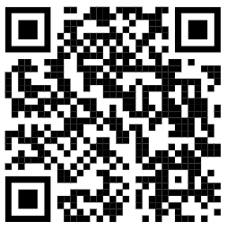
StatEWIDE UPDATES
Fall Leadership Conference Survey
  Share Your Opinions on:
    Potential Locations
    Programming
    Cost Preferences
    Implementation & Logistics
State Advisor & State Officer Visits
  State Advisor Sign-Up
  Team 83 Visit Request
Advisor Code of Ethics
  Due October 1st
Business Curriculum PD
  Open To All Business Educators
  October 30th @ Columbus State Delaware Campus
Complete FLC Survey

Slide 5

Rally Order
School-Based Enterprise Platform
  Hardware & Software
  Designed for Classroom Integration
Participating Schools Receive
  Two Free Terminals
    More Available Based on Volume
  No Annual or Monthly Fees
  No Minimums
  Free Tax Reporting
  District-Level Reporting and Oversight
  FERPA and COPPA Compliance

Slide 6
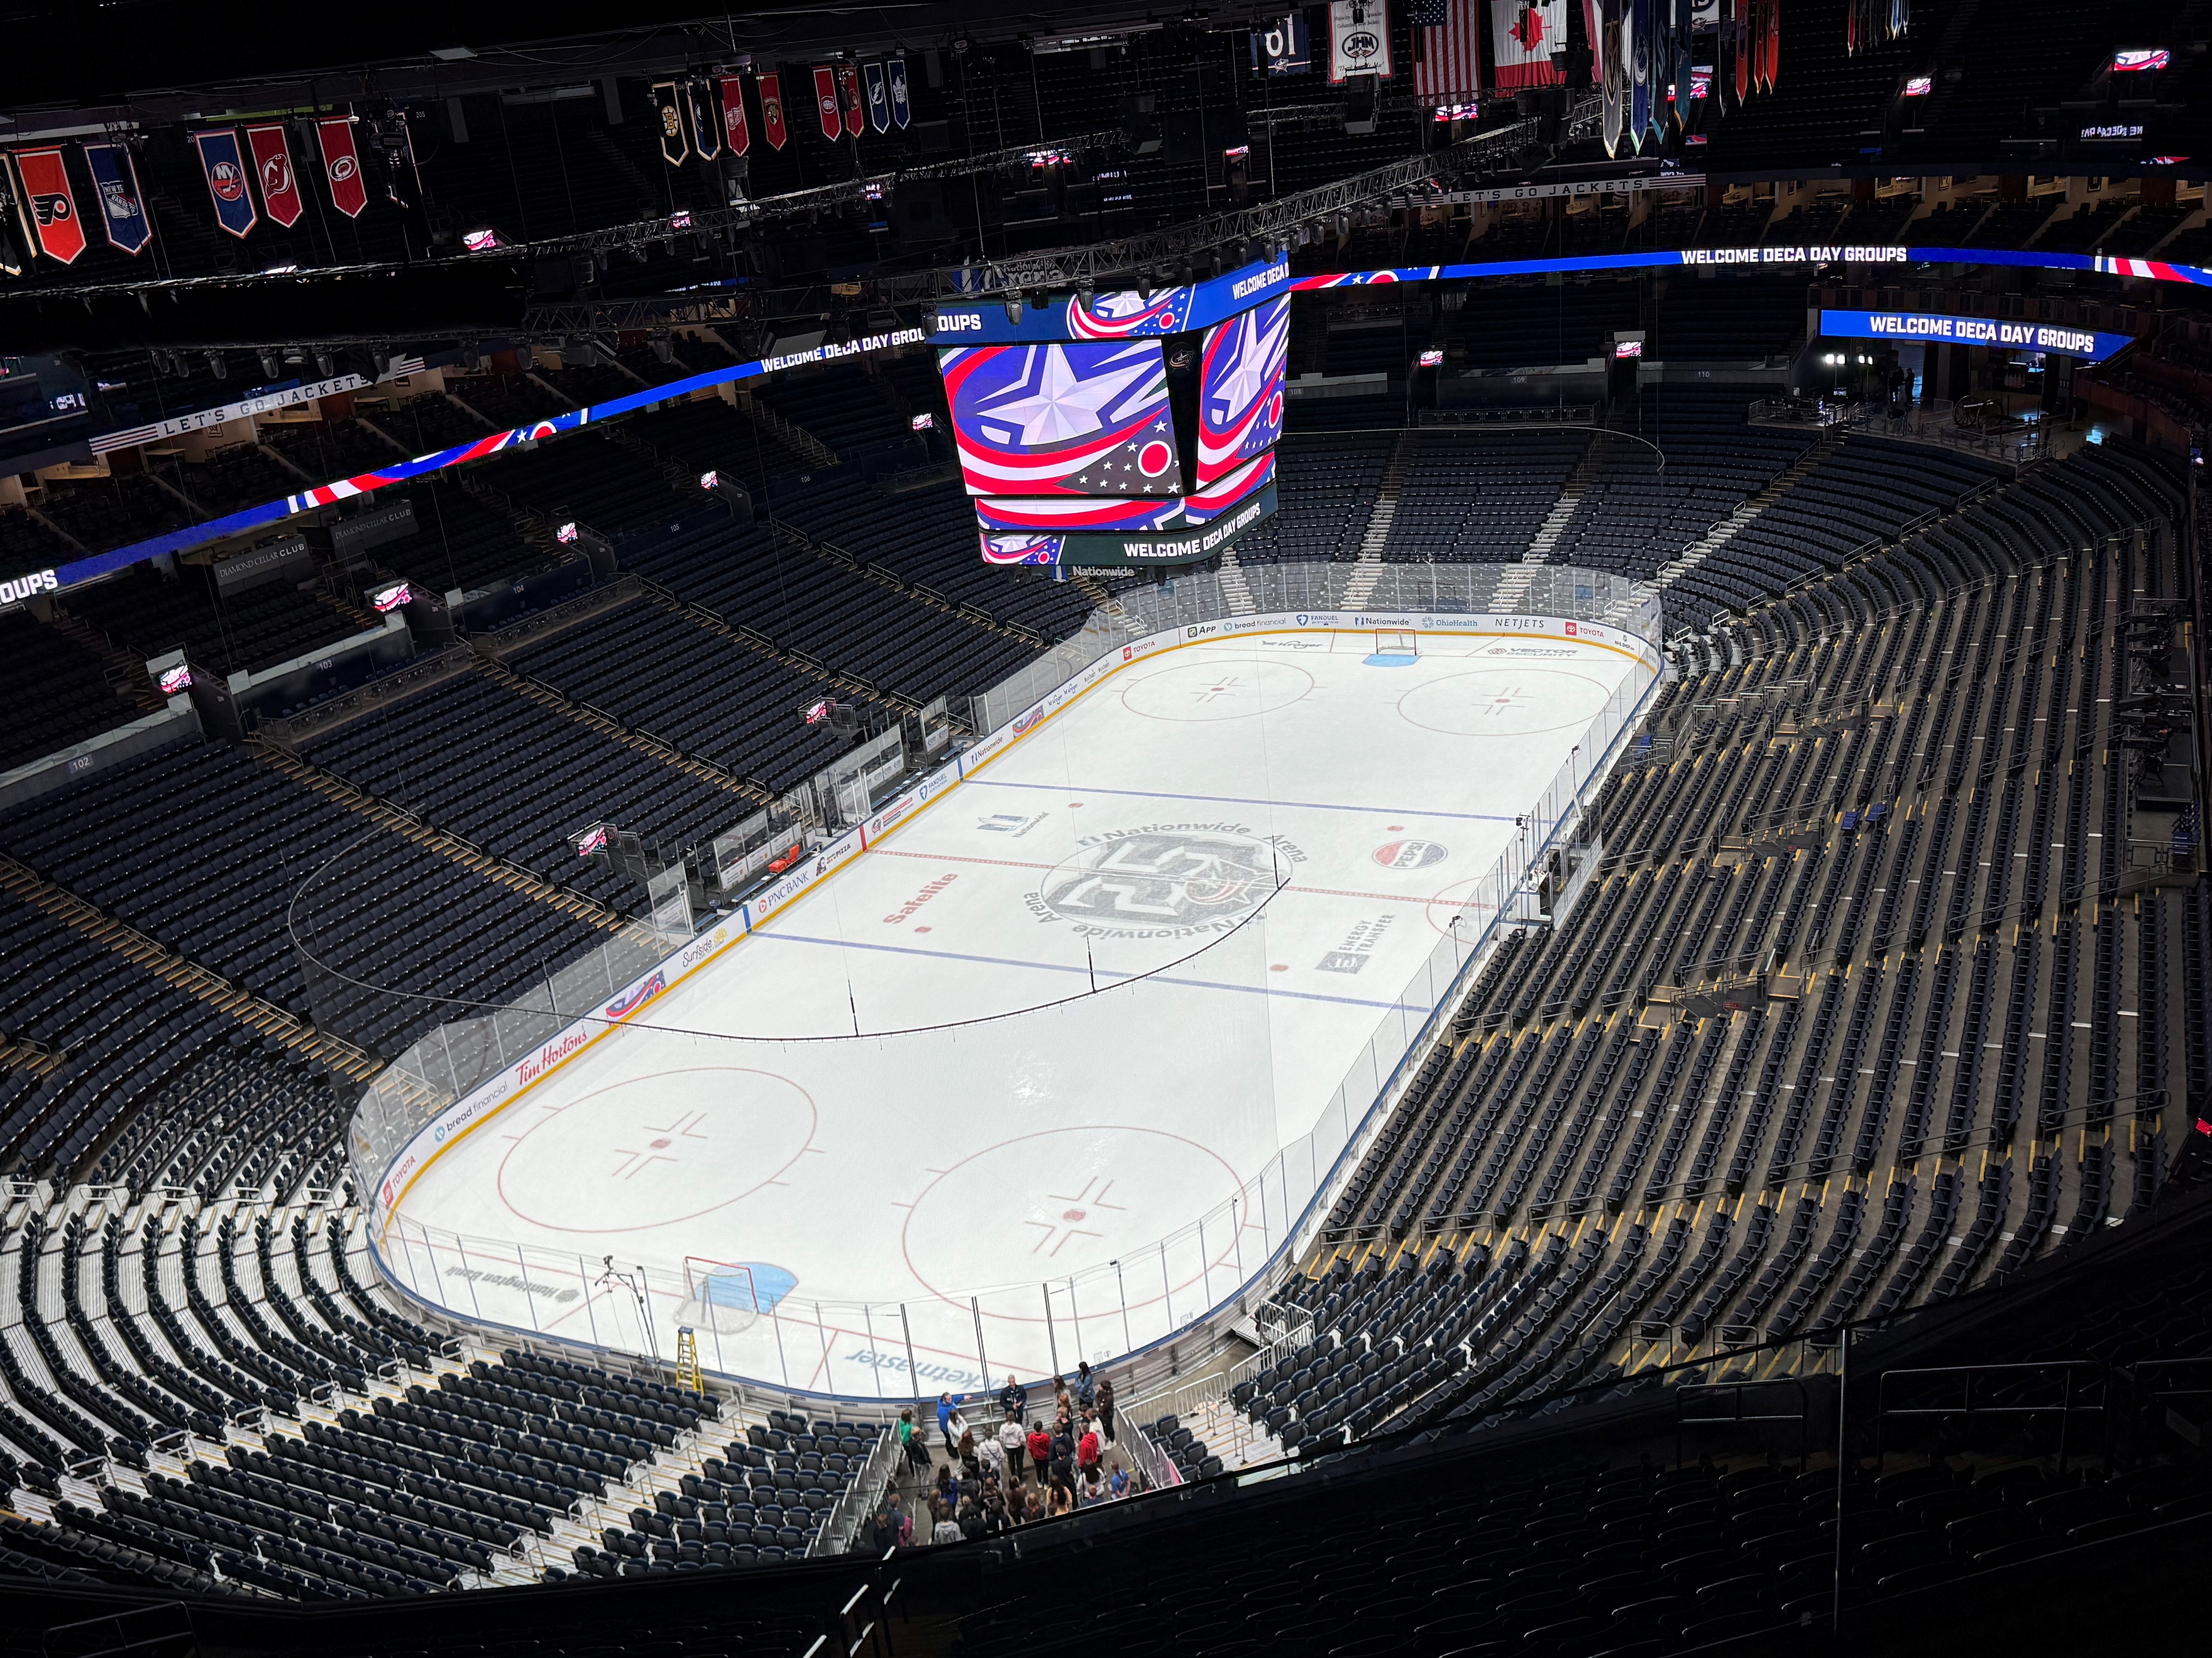
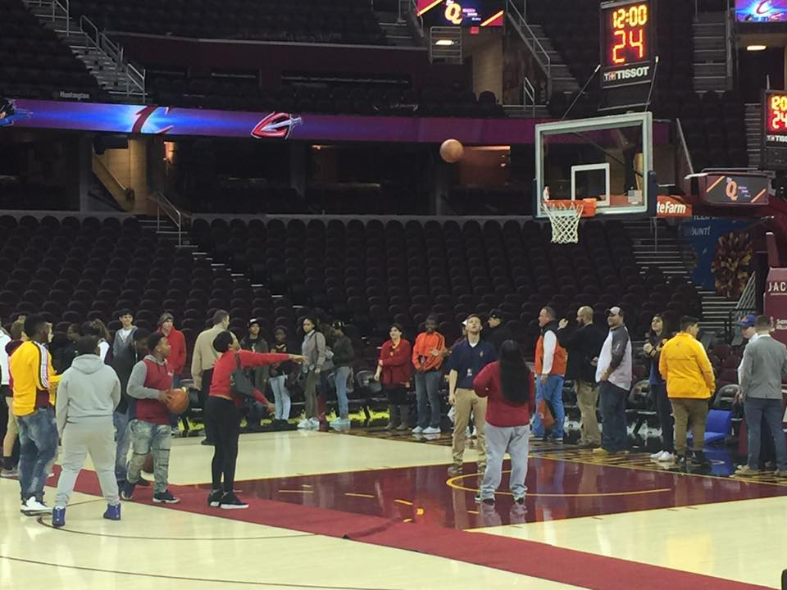
UPCOMING DECA DAYS
Columbus Blue Jackets
  Day #1: Tuesday, October 13th
    Registration Deadline: October 5th
  Day #2: Tuesday, November 3rd
    Registration Deadline: October 26th
  Industry Panel, Arena Tour, Skate Sessions
Cleveland Cavaliers
  Monday, November 16th
    Registration Deadline: October 16th
  Industry Panel, Arena Tour, Marketing Activity

Slide 7



Slide 8
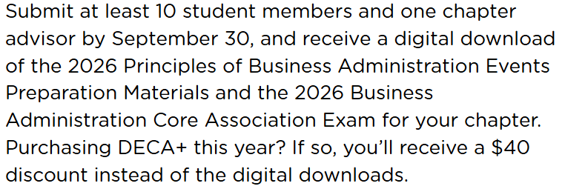
UPCOMING DECA, Inc activities
DECA Stock Market Game
Activate Your Chapter Incentive
  Register by September 30th
DECA Advisor Amped
  October 15th – 18th
  Boston, MA
  Deadline September 22nd
DECA Power Trip
  Deadline October 15th
DECA Virtual Business Challenge Round 1
  October 13th – 23rd

Slide 9
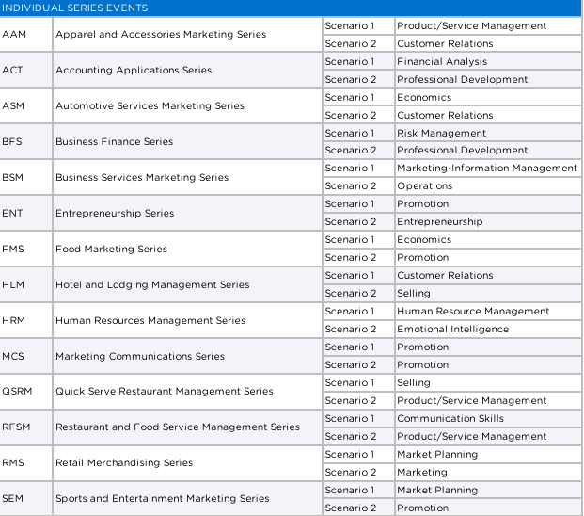
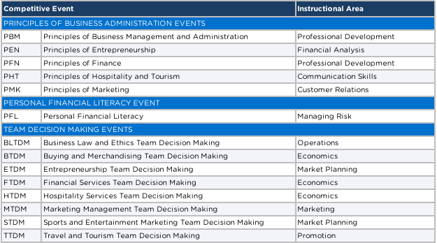
DISTRICT INSTRUCTIONAL AREAS
AVAILABLE TODAY!

Slide 10
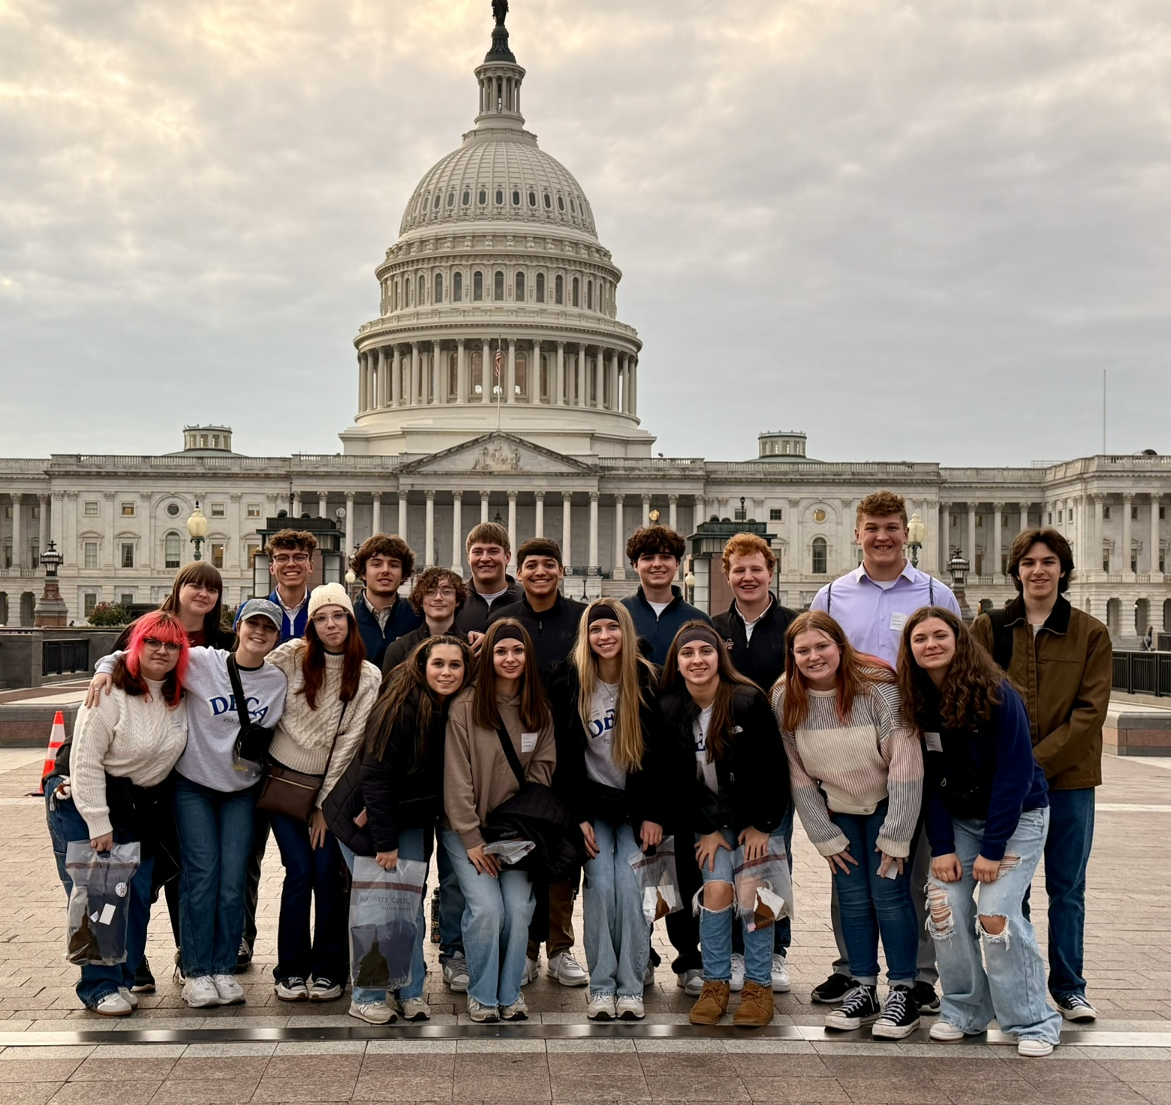
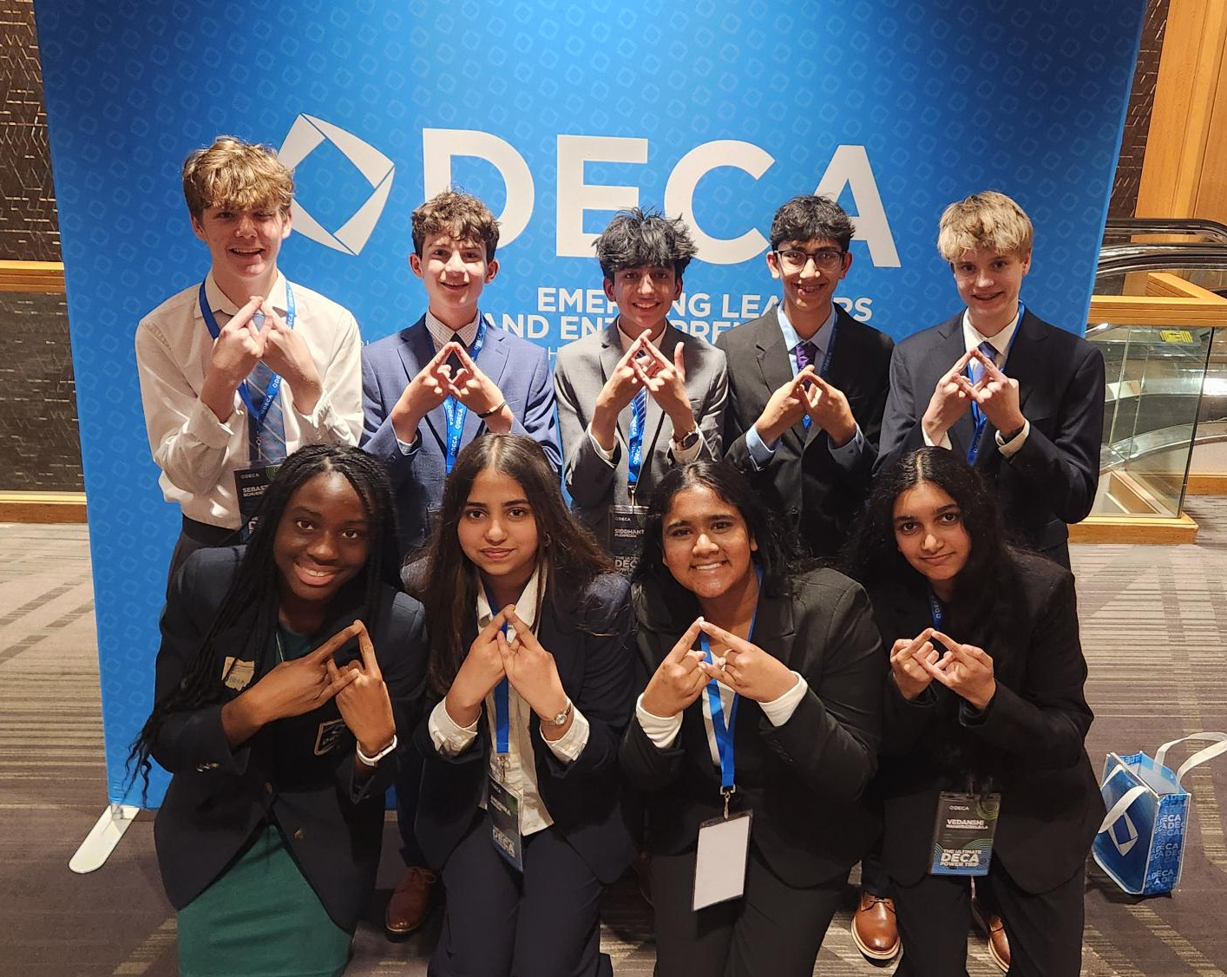
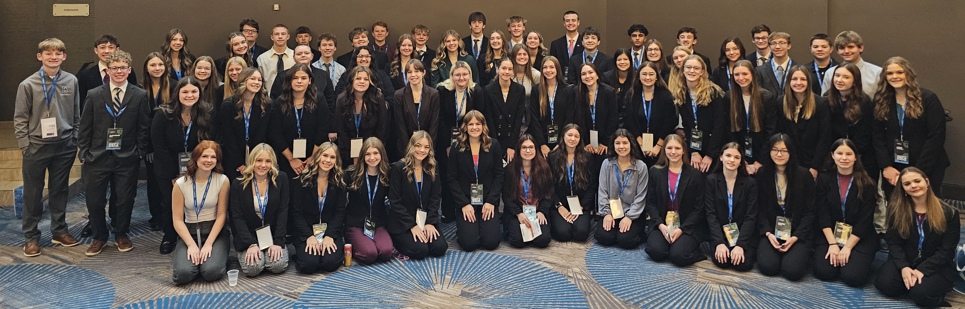
DECA Power Trip
November 20th – 22nd : Louisville, KY
Registration Deadline: October 15th
  Register directly through DECA, Inc.
  Select “Conferences” in Membership Portal
  Activities Include:
    Competitive Excellence Experience
    Learning and Leadership Labs
    College, Career + Company Exhibits
    General Sessions
    Educator Professional Learning Series
    DECA at the Downs
    DECA After Dark – Louisville Slugger Museum

Slide 11
QUESTIONS?

Slide 12
MEMBERSHIP & RECRUITMENT

Slide 13
Membership & Recruitment
How Do You Handle Registering Members?
  School vs. Student Funded
  Do you include anything with membership?
  How do you motivate to join?
  How do you recruit for program and/or chapter?
Professional & Alumni Members
  Do you have them at your chapter?
    What is your process for connecting with Professionals & Alumni
Membership Engagement & Best Practices

Slide 14
Membership System Walkthrough

Slide 15
QUESTIONS?

Slide 16
NEXT MEETING
October
THEME:
Campaigns & Competition

Slide 17
Ohio DECA
Monthly Advisor Meeting
Tuesday, September 15th 2026

