Slide 1
Ohio DECA
Back to School Welcome
Tuesday, August 25th 2026

Slide 2

Agenda
2025-2026 Recap
Updates for 2026-2027
  DECA, Inc.
  Ohio DECA
Upcoming DECA Days
Important Dates
Team 83 Initiatives
Questions

Slide 3
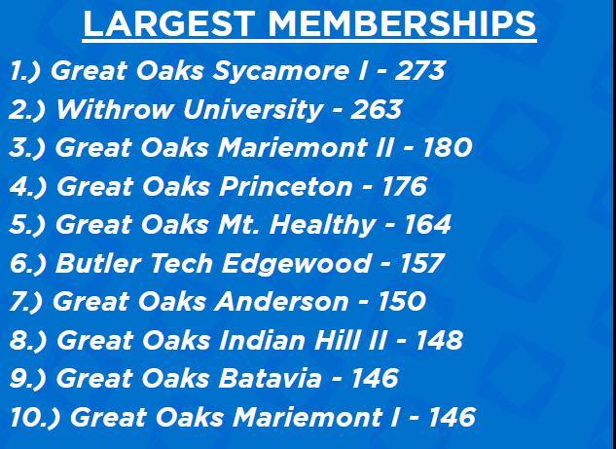
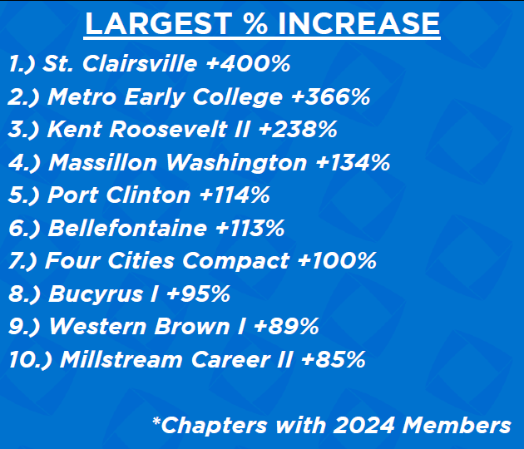
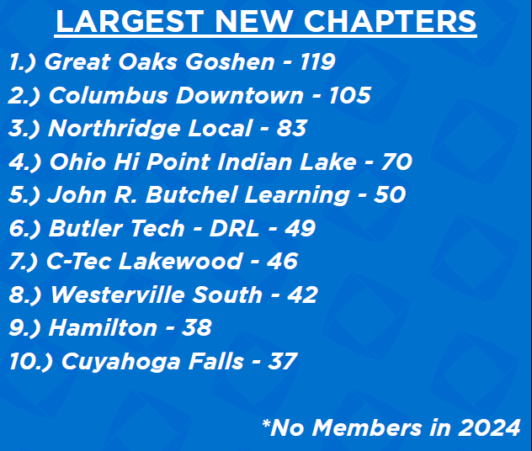
2025-2026 Year in review
8,008 Members
  Students: 7,324
  Advisors: 134
  Alumni: 313
  Professional: 237
Over 3,000 CDC Participants
ICDC Performance
  31 Top 20 Teams
    15 in Top 10
    4 Competitive Event Winners
    1 Challenge Winner

Slide 4
2025-2026 Year in review
Membership Info | 2025-2026 | 2024-2025 | % Change | Membership Info | 2025-2026 | 2024-2025 | % Change
District 1 | 562 | 495 | 14% | District 8 | 504 | 575 | -12%
District 2 | 472 | 419 | 13% | District 9 | 354 | 444 | -20%
District 3 | 575 | 356 | 62% | District 10 | 717 | 527 | 36%
District 4 | 688 | 525 | 31% | District 11 | 446 | 283 | 58%
District 5 | 680 | 512 | 33% | District 12 | 680 | 485 | 40%
District 6 | 1,020 | 839 | 22% | District 13 | 774 | 659 | 17%
District 7 | 559 | 465 | 20%
*Redistricted in 2025

Slide 5

DECA Inc. Updates
Chapter Campaigns
  Community Service, Promotional, Advocacy etc.
  MUST Use Adobe Express for Submissions
  Contact me if District Blocks Adobe
School-Based Enterprises
  $25 Application Fee Now Required for Certification
Competitive Events
  New Evaluation Levels (Page 40-41)
  Five PIs for Team Decision Making
  Prepared Events now 50%/50% for Paper/Presentation (200 Total)
  Presentation Technique now part of Presentation Rubrics
Review DECA Guide (Page 4)

Slide 6
OHIO DECA Updates
Executive Council
  District 2: Cara Maxey, Penta-Bowling Green
  District 12: Mike Goins, Western Brown
Competitive Events & CDC
  20 Page Written Event Pre-Registration (Required)
  Earlier Prepared Event Submission Deadline
  Standard Deviation/Weighted Model for Prepared Event Judging
    Judges NO LONGER Reading All Papers for Event
  Statewide Substitution Policy
  No Finals Schedule Accommodation Requests Accepted
  Monday CDC Testing Session
Additional Team 83 State Officer Support
Advisor Code of Ethics
Detailed Breakdowns and Discussions Regarding CDC and Competitive Event changes will be included in:
Competitive Events Guide
Advisor Professional Development
Competitive Events Deep Dives

Slide 7
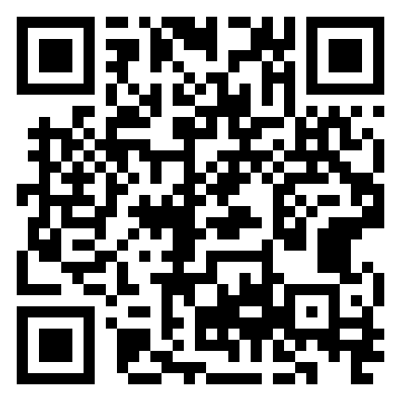
ADVISOR CODE OF ETHICS
Behavior & Professionalism
Conference Accountability
AI Usage Policy
Electronic Form
  Advisors | Ohio DECA
  Jotform
Due by October 1st
Complete Here!

Slide 8


DECA ADVISOR
Professional Development
Friday, September 25th
  Nationwide Arena
  8:00AM – 4:00PM
DECA Inc & Ohio DECA Updates
Advisor Best Practices
Competitive Event Deep Dive
Chapter Management
Adobe Express
Sign-Up Here!

Slide 9
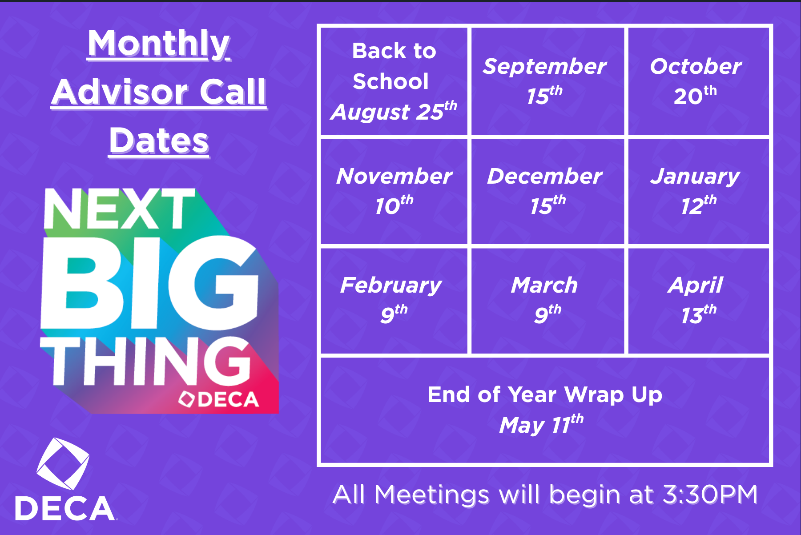
Monthly advisor calls
1st Half - Monthly Updates
2nd Half - Topic Based
Seasonal Best Practices
  Membership
  Competitive Events
  Scholarships
Q/A

Slide 10

Monthly NEWSLETTERS
Chapter Spotlights
Advisor Spotlights
State Officer Announcements
Important Dates
Upcoming Events
Make Submissions Monthly

Slide 11
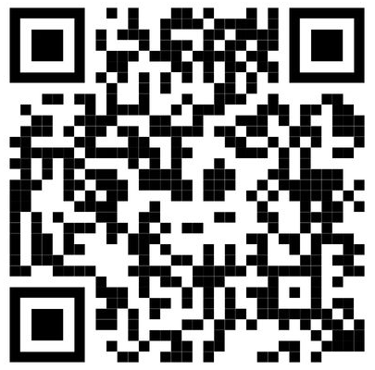
State Advisor Site Visits
Scheduled Meetings & Visits
  In-Person
    Complete State Advisor Visit Interest Form
    Regional Plan To Be Developed Based on Interest
    Deadline for Requests: Friday, September 18th by 5:00PM
  Virtual
    Schedule directly through My Bookings
Potential Visit Content
  General Class/Chapter Visit
  Advisor/Officer Meeting
  Workshops/Best Practices
    General Chapter Strategies
    Leadership
    Competitive Events
Complete Here!

Slide 12


TEENS TEACH TECH
Community Service
  Earn Community Service Hours
Student Led Workshops
Flexibility with Programming
Fundraise for Chapter
  Start-Up Funds (Grant Provided)
  Can Earn $10 Per Adult (Will Lasts)
If interested:
  Contact Jess Golson
  jgolson@connectednation.org

Slide 13



Upcoming DECA DAYS
Cincinnati Reds
  September 17th vs Dodgers
  Contact RBurns@reds.com
Cedar Point
  October 2nd
  DLG Registration Required
Blue Jackets
  Day #1: October 13th
  Day #2: November 3rd

Slide 14
Important Dates – 1st Semester
September 17th – DECA Day @ Cincinnati Reds
  Registration Due September 14th
September 25th – DECA Advisor Professional Development (Nationwide Arena)
  Registration Due September 21st
October 2nd – Ohio DECA Day at Cedar Point
  Registration Due September 15th
October 13th – DECA Day #1 at Columbus Blue Jackets
  Game vs. Florida Panthers @ 6:15pm
October 30th – Deadline for Ohio DECA Pin & Shirt Design Contest
  Online Voting November 9th – 13th
November 3rd – DECA Day #2 at Columbus Blue Jackets
November 15th – Deadline for Initial Membership Registration
  Initial Membership Numbers determines State Competitive Event Allocations
November 20th – 22nd – The Ultimate DECA Power Trip (Louisville, Kentucky)
  Registration Due October 15th at www.deca.org/power
December 1st – DECA Inc. Chapter & Membership Campaigns Due
December 18th – Pre-Registration for 20 Page Written Prepared Events (Required)
DECA Day at Cleveland Cavaliers
November (Date Yet To Be Finalized)

Slide 15
Important Dates – 2nd Semester
January 11th – DECA Inc. Scholarship Applications Due
January 11th – Ohio DECA CDC Registration Opens
  Registration Closes at 5:00PM on January 25th
January TBD – Deadline for State Officer Applications
January 22nd – Deadline to Upload CDC Written Events to DLG by 5:00PM
January 27th – 31st – DECA Sports & Entertainment Marketing Conference (Orlando, Florida)
  Registration Due December 2nd
February 6th – State Officer Screening
  Location TBD
February 22nd – 24th – Ohio DECA CDC – Hyatt Regency Columbus & Greater Columbus Convention Center
March 10th – Deadline for DECA ICDC Conference Registration
March 30th – DECA ICDC Written Event Uploads Deadline
April 17th – 20th – DECA ICDC (Anaheim, California)

Slide 16

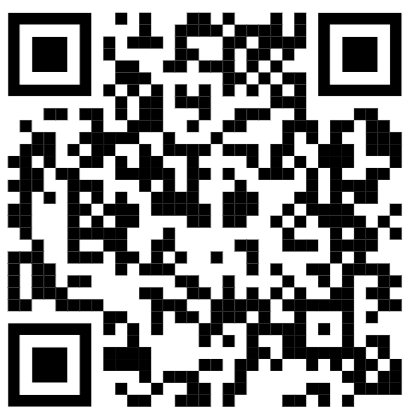
TEAM 83 Initiatives
Brave Like Me
Connect Calls
  Competition
  Ohio DECA Updates
Leadership Calls
Chapter Visits
  State Officers | Ohio DECA
Request a Visit!

Slide 17

OHIO DECA GROUP ME
Please have your members sign-up for the Ohio DECA Group Me!
This group chat will help increase communication with members throughout the state!

Slide 18
QUESTIONS?

Slide 19
NEXT MEETING
September 15th
THEME:
Membership &
CHAPTER STRATEGIES

Slide 20
Ohio DECA
Back to School Welcome
Tuesday, August 25th 2026

