Slide 1
Ohio DECA October advisor Meeting
Tuesday, October 20th 2026

Slide 2

Agenda
Statewide Updates
Competitive Events Guide
Upcoming Reminders
DECA Chapter Campaigns
Intro to Competitive Events
General Competition Q & A

Slide 3
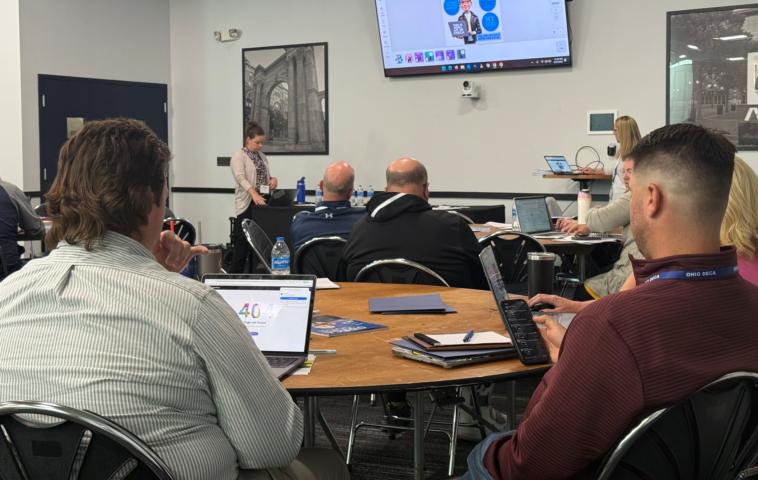
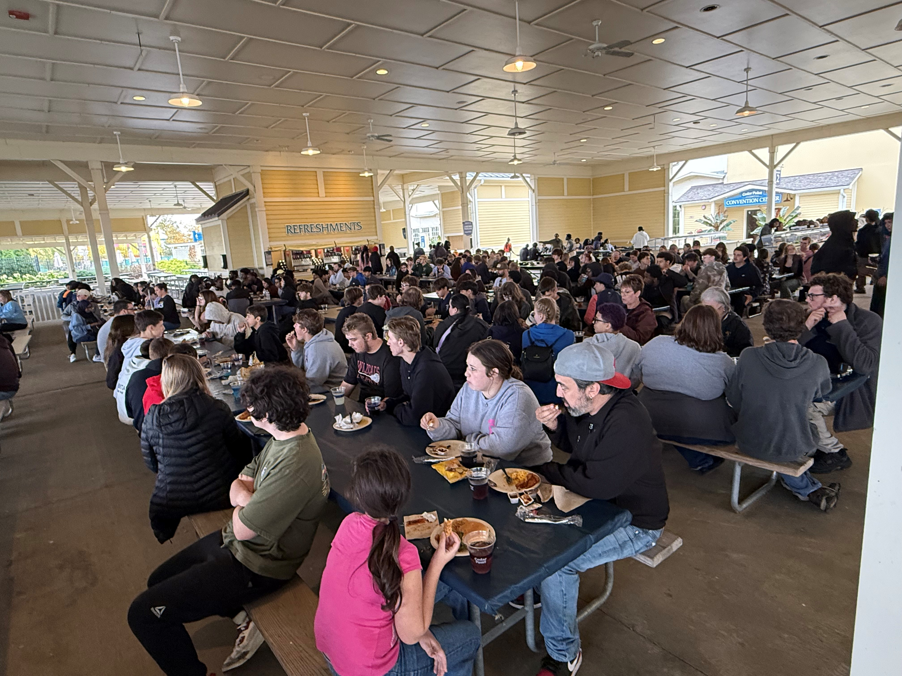
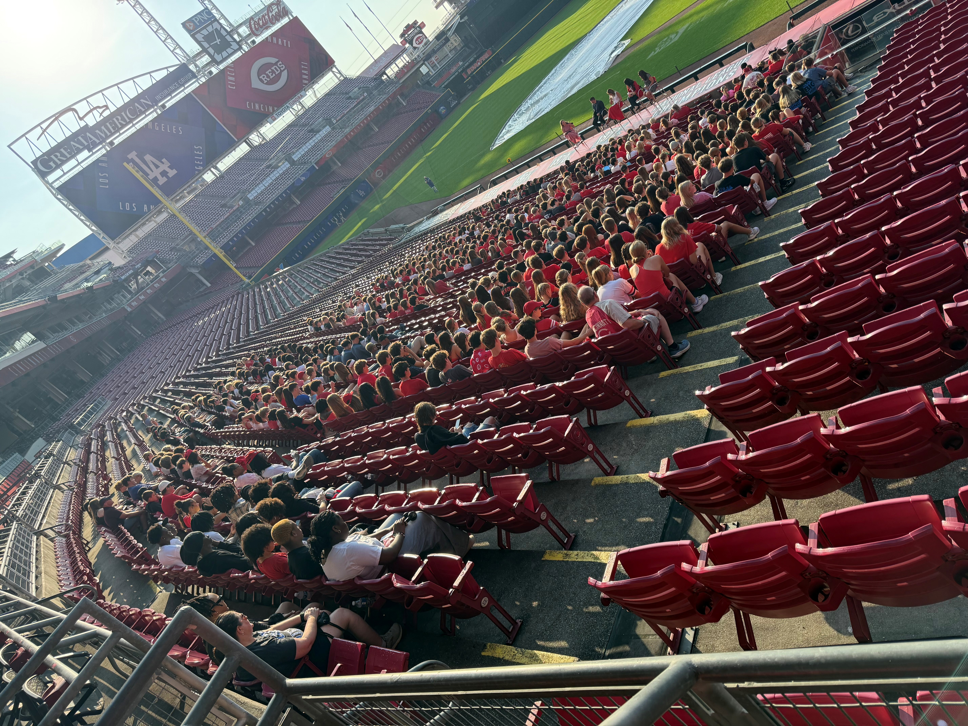
StatEWIDE UPDATES
Membership Numbers
  Chapters: 98
  Members: 5,530 (5,105)
DECA Power Trip
  Chapters: 14
  Attendees: 144
Cedar Point, CBJ #1, Guardians & Reds Recap
Advisor PD Recap
Pin & T-Shirt Design Contest
  Entries Due October 30th

Slide 4

Competitive Events Guide
Available Now!
DECA Inc. Updates
  Prepared Events Changes
  Competitive Event Observations
Ohio DECA Updates
  20-Page Written Event Pre-Registration
  Standard Deviation Tabulation Model
  Statewide Substitution Policy
  Event Coordinators

Slide 5
MEMBERSHIP BY DISTRICT
District 1: 387 (557)
District 2: 447 (463)
District 3: 498 (557)
District 4: 473 (684)
District 5: 495 (669)
District 6: 623 (976)
District 7: 367 (513)
District 8: 259 (454)
District 9: 202 (354)
District 10: 227 (714)
District 11: 251 (444)
District 12: 557 (680)
District 13: 743 (770)
*2025 membership in parenthesis

Slide 6
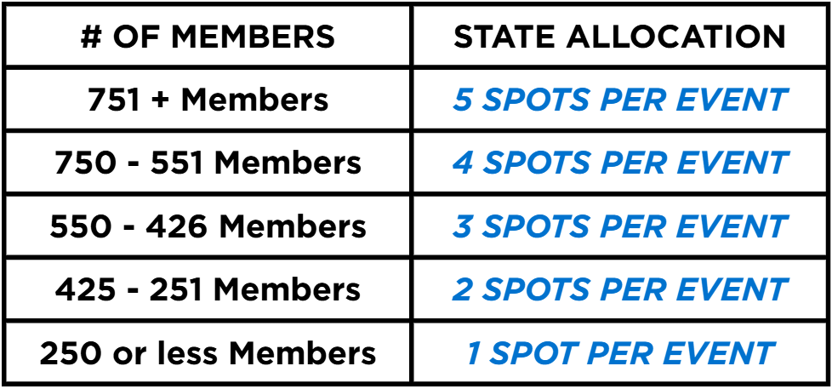
Reminders
Initial DECA Membership Registration
  November 15th
  Impacts District Allocations
Upcoming DECA Days
  CBJ Day #2 – November 3rd
  Cavaliers – November 16th
  OSU Basketball – January 26th
October Newsletter – Available Now!
  November Newsletter Submissions
DECA Inc. Campaigns
  Due December 1st
Membership Tiers

Slide 7
QUESTIONS?

Slide 8
CAMPAIGNS &
COMPETITION

Slide 9
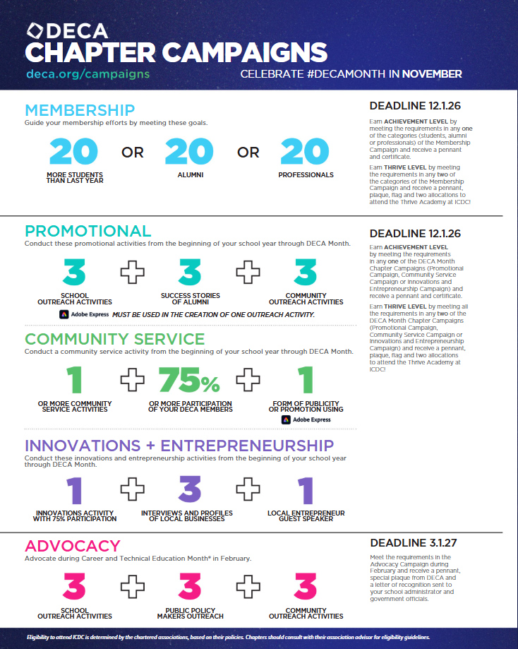
DECA Chapter Campaigns
Campaign Types
  Membership
  Promotional
  Community Service
  Innovations & Entrepreneurship
  Advocacy
Does Your Chapter Participate?
  Best Practices
  Types of Activities
  Classroom Integration
Achievement vs. Thrive Level
New Adobe Requirements
How To Submit

Slide 10
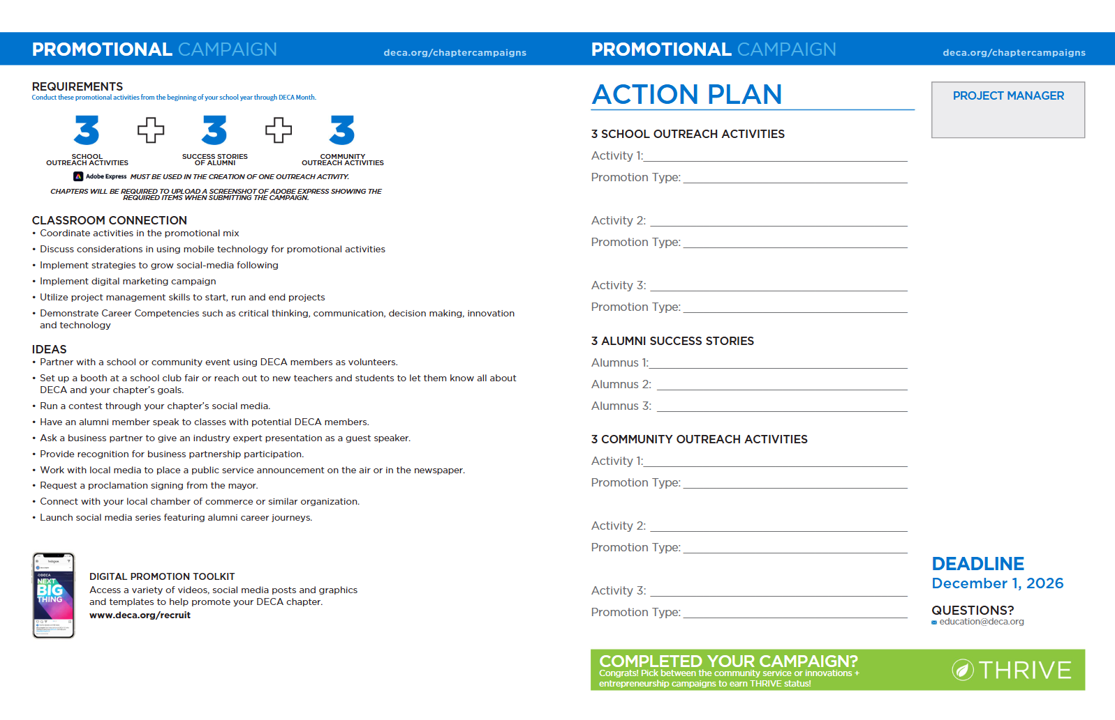

Slide 11
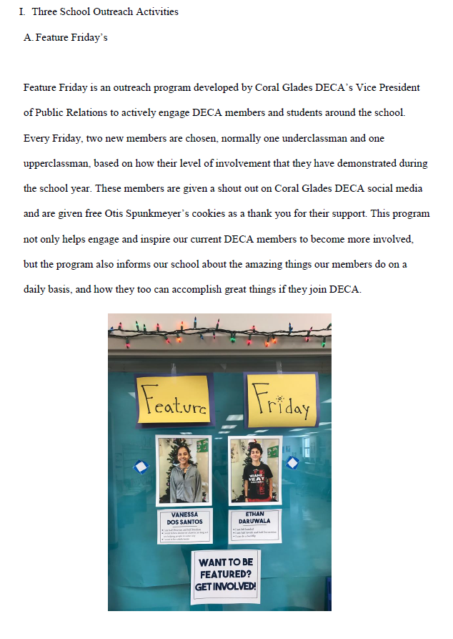
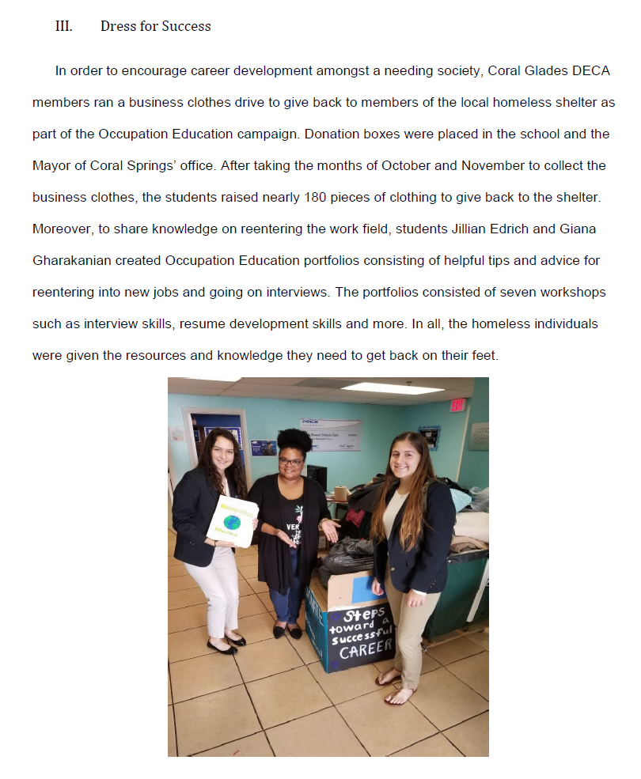

Slide 12

Intro to Competition
Competition Types
  Testing/Role Play
  Prepared Events
  Virtual (SMG/VBC) (ICDC Only)
Initial Introduction
  Best Practices
  Category/Partner Selection
  Chapter Focus
Recommendations
  Start Small
  Single Competition Type
  Don’t Overwhelm
CAREER CLUSTERS

Slide 13

Competition Logistics
Each District Varies for:
  Registration
  Competition Logistics
  # of CDC Qualifiers
Ohio DECA State CDC
  Registration Due January 25th
  Preliminary Round (Monday & Tuesday)
    On-Site Scantron Testing (Both Days)
    One Presentation/Role Play (Tuesday)
  Finals Round (Wednesday)
    Achievement Awards - Morning
    One Final Presentation (Test & Paper Scores Move Forward)
    Top 6 – Individuals/Teams/Principles advance to ICDC
    Top 5 – Prepared Events advance to ICDC
DECA ICDC
  Registration Due March 10th
  Preliminary Round
    On-Site Scantron Testing
    One Presentation/Role Play (Individual Series has TWO RPs)
  Finals Round
    Achievement Awards
    Top 20 ICDC Finalists Compete Again
    One Finals Presentation/Role Play
      Test Score Moves Forward/Paper Is Graded Again
    Grand Awards
      Top 10 Recognition
      Trophies for 1st, 2nd and 3rd

Slide 14
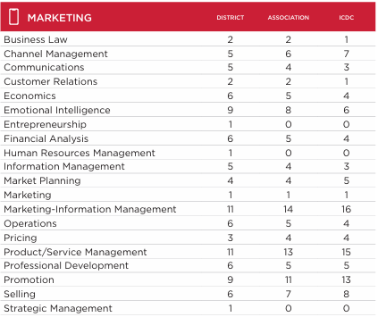
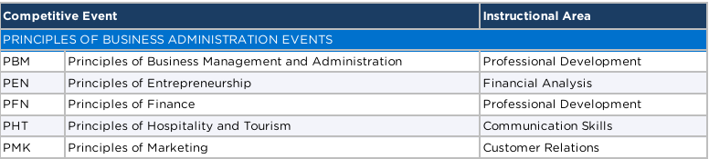
PREPARATION TECHNIQUES
Exam Blueprint
District Instructional Areas
Mock Competitions
Bootcamps & Practice Sessions
Volunteer Assistance
Written Event Sessions
Classroom Integration
  In-Class Role Plays
  Daily DECA Questions

Slide 15
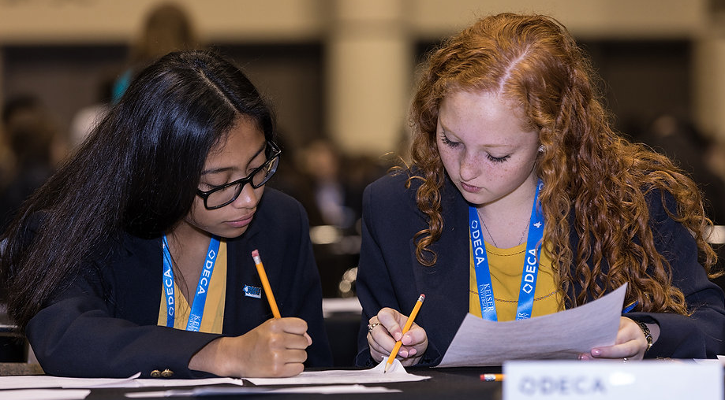
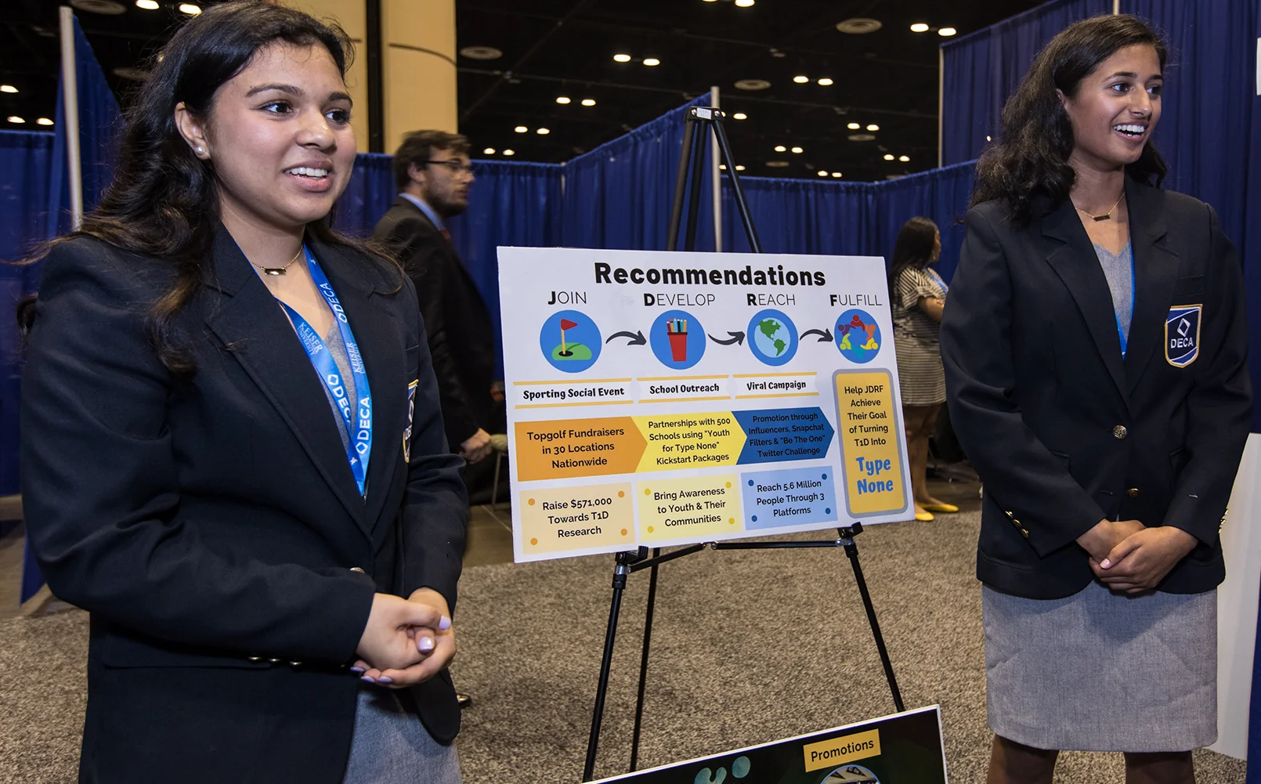
RESOURCES
Ohio DECA Competitive Events Gude
Ohio DECA Advisor CDC Guide
DECA Guide
DECA +
Sample DECA Tests & Role Plays
Sample Written Events
Role Play & Presentation Videos
Performance Indicator Document

Slide 16
QUESTIONS?

Slide 17
NEXT MEETING
NOVEMBER 10th
THEME:
Written Event Registration, Officer Application
& SCHOLARSHIPS

Slide 18
Ohio DECA October advisor Meeting
Tuesday, October 20th 2026

